Slide 1



Bridging Language in Machines and Language in the Brain
Subba Reddy Oota^{1,2,3}, Mounika Marreddy⁴, Raju S. Bapi⁵
¹Inria Bordeaux, France; ²MPI for Software Systems, Germany; ³TU Berlin, Germany,
⁴University of Bonn, Germany; ⁵IIIT Hyderabad, India;
subba-reddy.oota@inria.fr, mmarredd@uni-bonn.de, raju.bapi@iiit.ac.in

Slide 2
Agenda
Neuro-AI alignment: Introduction [1 hour 15 min]
Introduction to Brain encoding and decoding [30 min]
Types of Brain Recordings [15 min]
Types of Stimulus Representations [30 min]
Coffee break [30 min]
Recent Trends in LLMs [1 hour 15 min]
Small language models [20 min]
Emerging abilities of language models [15 min]
Text-to-Text Transfer Transformer, Prompting, Instruction-tuning [40 min]
Lunch break [1 hour 30 min]
Language and Brain: Deep Learning for Brain Encoding and Decoding [1 hour 30 min]
Linguistic Brain Encoding [45 min]
Linguistic Brain Decoding [30 min]
Coffee break [30 min]
Hands-on-session [1 hour 15 min]

Slide 3
Agenda
Neuro-AI alignment: Introduction [1 hour 15 min]
Introduction to Brain encoding and decoding [30 min]
Types of Brain Recordings [15 min]
Types of Stimulus Representations [30 min]
Coffee break [30 min]
Recent Trends in LLMs [1 hour 15 min]
Small language models [15 min]
Emerging abilities of language models [30 min]
Text-to-Text Transfer Transformer, Prompting, Instruction-tuning [30 min]
Lunch break [1 hour 30 min]
Language and Brain: Deep Learning for Brain Encoding and Decoding [1 hour 15 min]
Linguistic Brain Encoding [60 min]
Encoding pipeline
Pretrained language models and brain alignment
Challenges in using DL for cognitive science
What are the reasons for better brain alignment?
Linguistic Brain Decoding [15 min]
Coffee break [30 min]
Hands-on-session [1 hour 15 min]

Slide 4
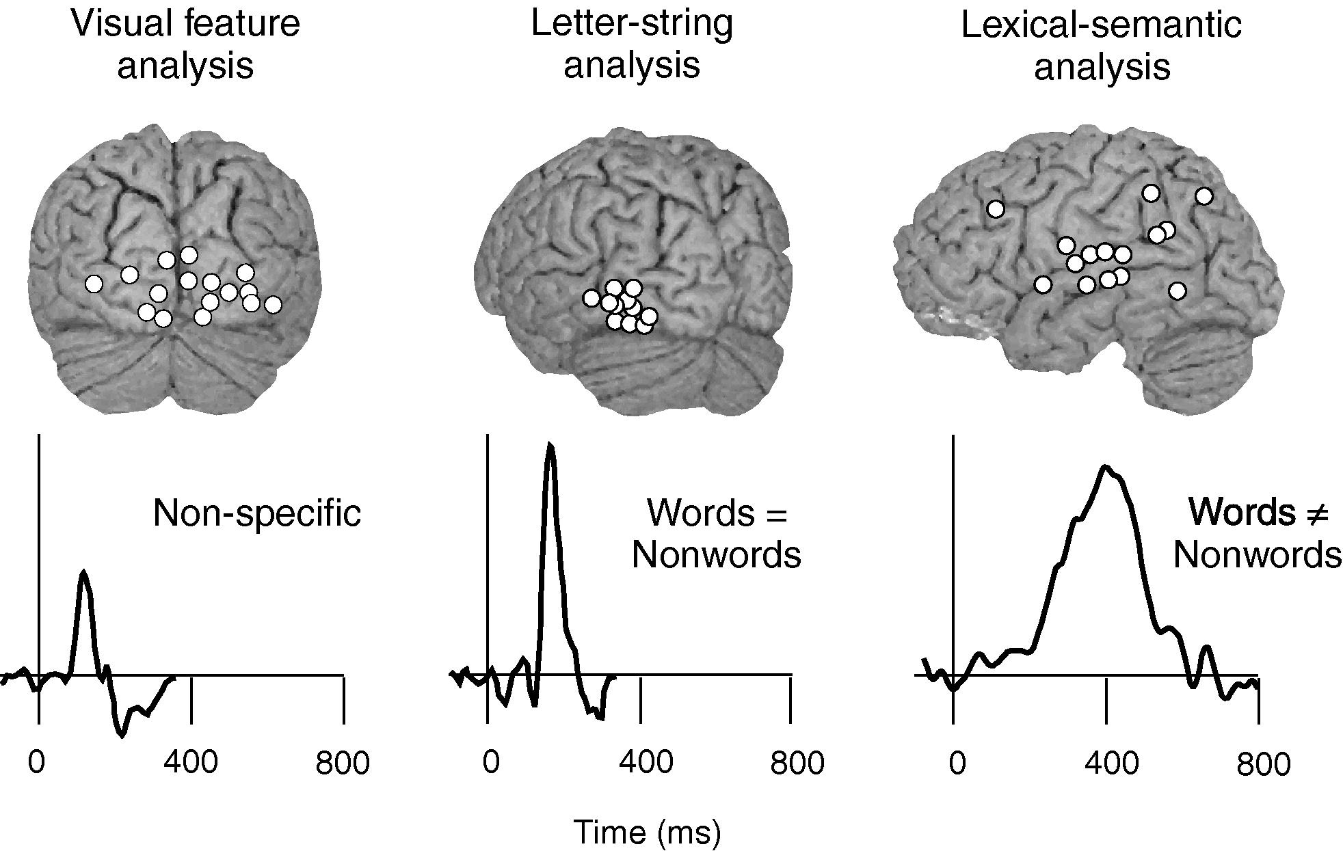
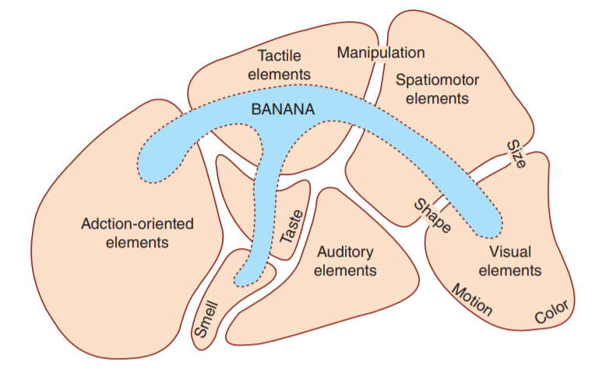
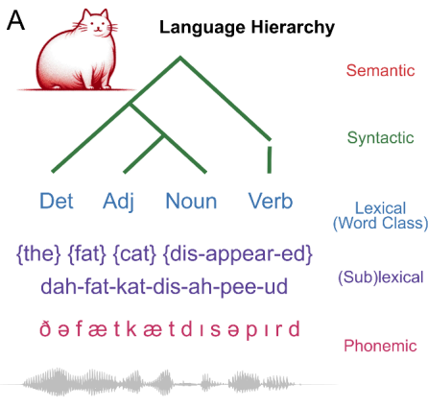
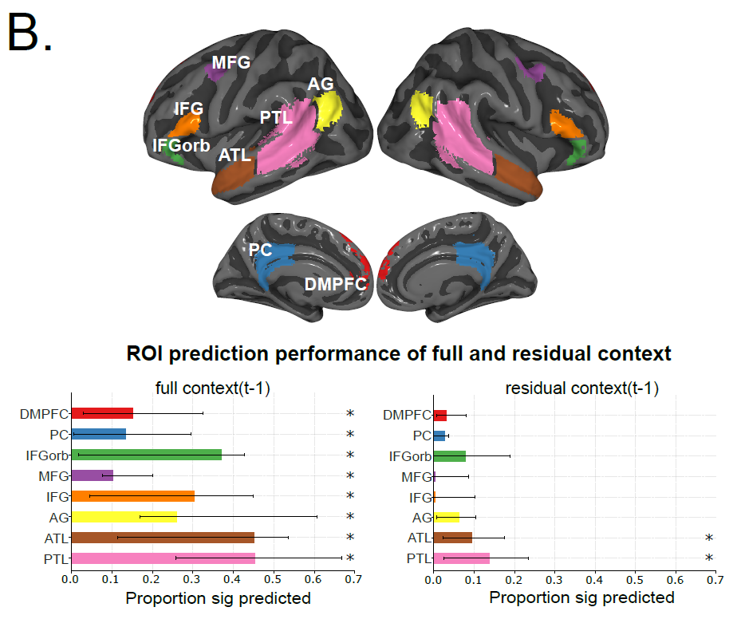
Mechanistic understanding of language processing in the brain: four big questions
What
When
Where
How
[Fedorenko et al. 2010, 2014]
Gwilliams et al. 2024
Notes:
Fundamental questions about what information is processed where, when, and how in the brain

Slide 5
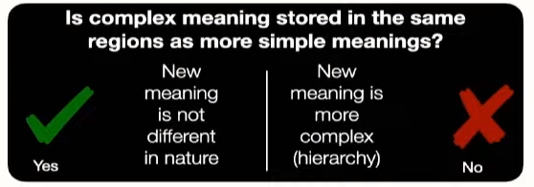
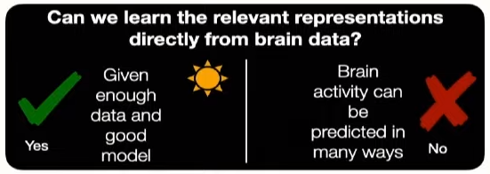
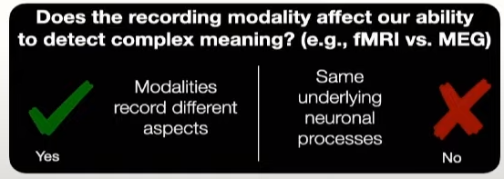
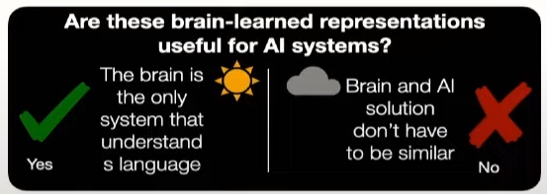
How does brain represents complex meaning? (Where, When and What)

Slide 6
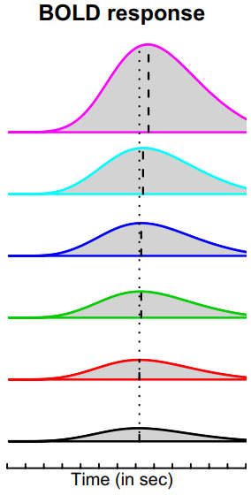
Typical studies of language processing with controlled experiments
How the human brain computes and encodes syntactic structures?
Syntax: how do words structurally combine to form sentences and meaning?
Controlled experiments
Structured complex sentence
Word lists
I believe that you should accept the proposal of your new associate
thing very tree where of watching copy tensed they states heart plus
Pallier et al. 2011
Notes:
controlled experiments that design artificial stimuli to separate the brain activation
such as comparing structured complex sentences or phrases with word lists
many valuable findings and have identified several brain regions, including the left temporal lobe and the left frontal lobe, that are involved in syntactic structure building
However, as designing artificial stimuli can only separate situations with or without structurebuilding

Slide 7
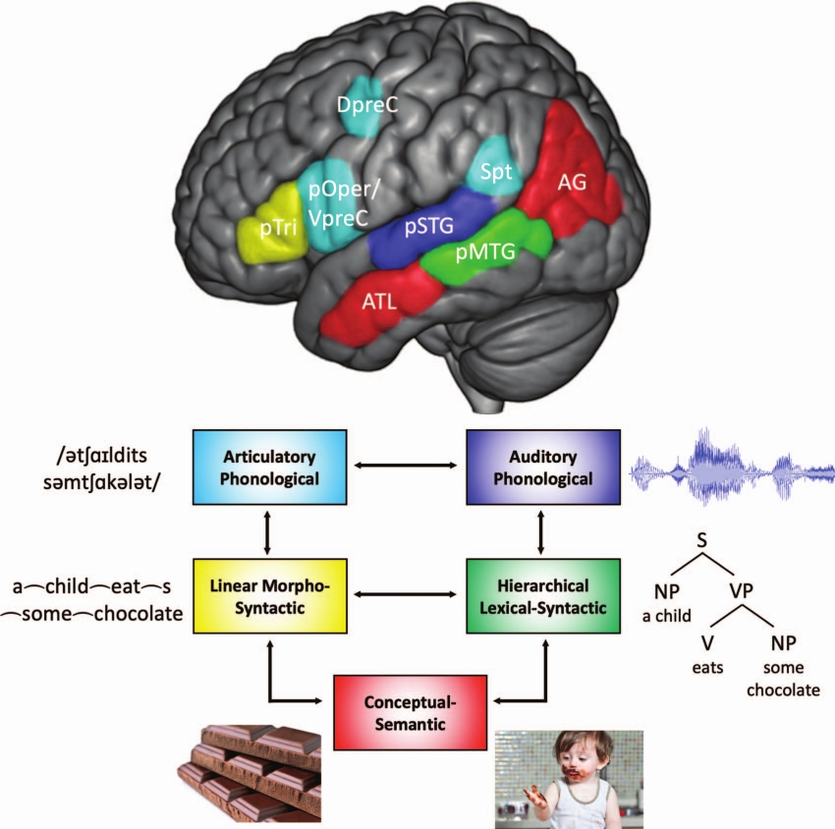

Language organization in the brain
Controlled experiments are task-based and not ecological
Brain process language at different features
Hierarchical syntactic information occurs in the cortical zone situated between auditory-phonological and semantic zones.
Matchin & Hickok et al. 2022
ICETCI 2024: DL for Brain Encoding and Decoding

Slide 8
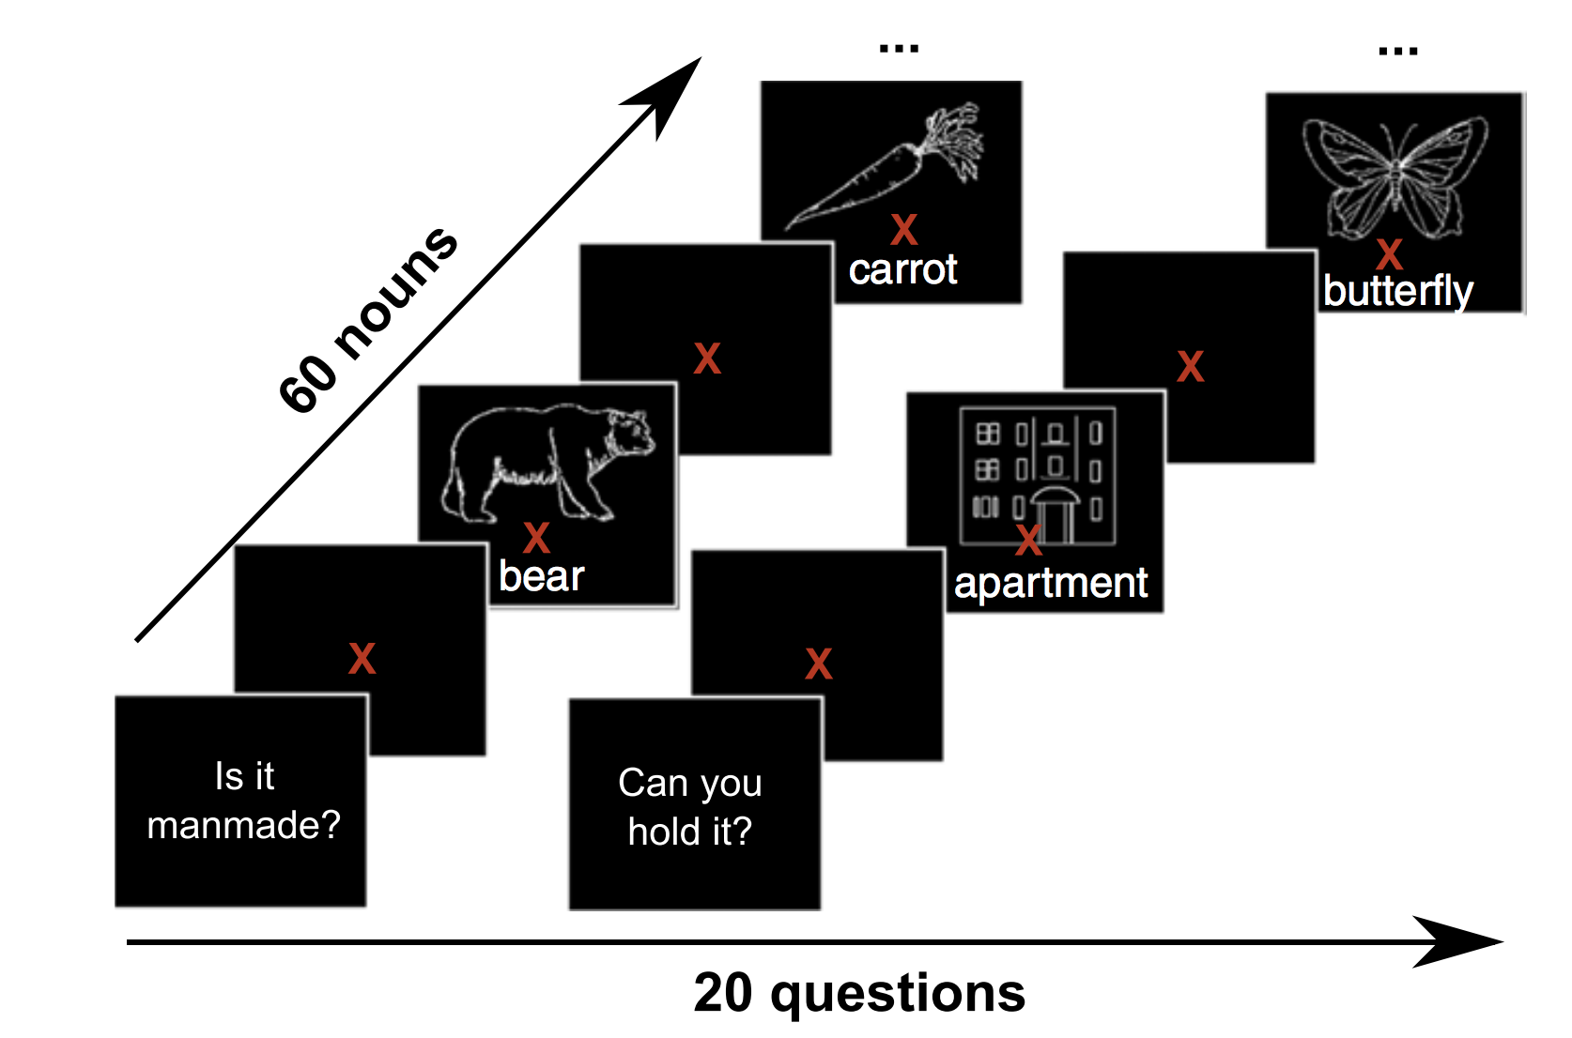
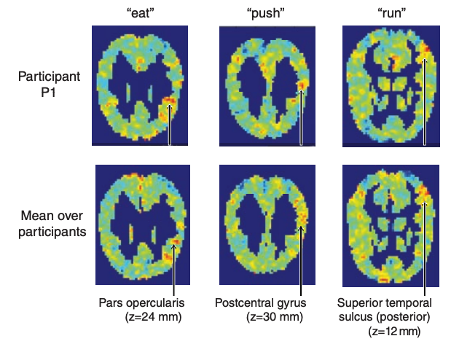
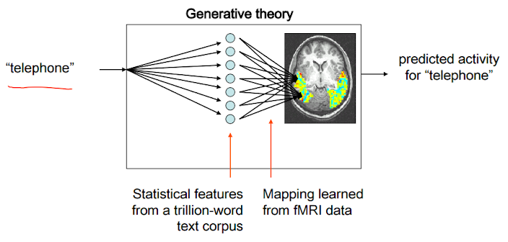
Classic encoding model finding: Language
bear
Stimuli: concrete nouns + line drawings
Stimulus representation: corpus co-occurrence counts with 25 sensory-motor verbs (e.g. see, hear, taste, smell)
Brain recording: fMRI
Correspondences
between a semantic property (“push”) and the function of the cortical regions where the fMRI recordings are well predicted
Accurately predicts fMRI recordings for a novel word
Mitchell, Tom M., Svetlana V. Shinkareva, Andrew Carlson, Kai-Min Chang, Vicente L. Malave, Robert A. Mason, and Marcel Adam Just. "Predicting human brain activity associated with the meanings of nouns." science 320, no. 5880 (2008): 1191-1195.

Slide 9
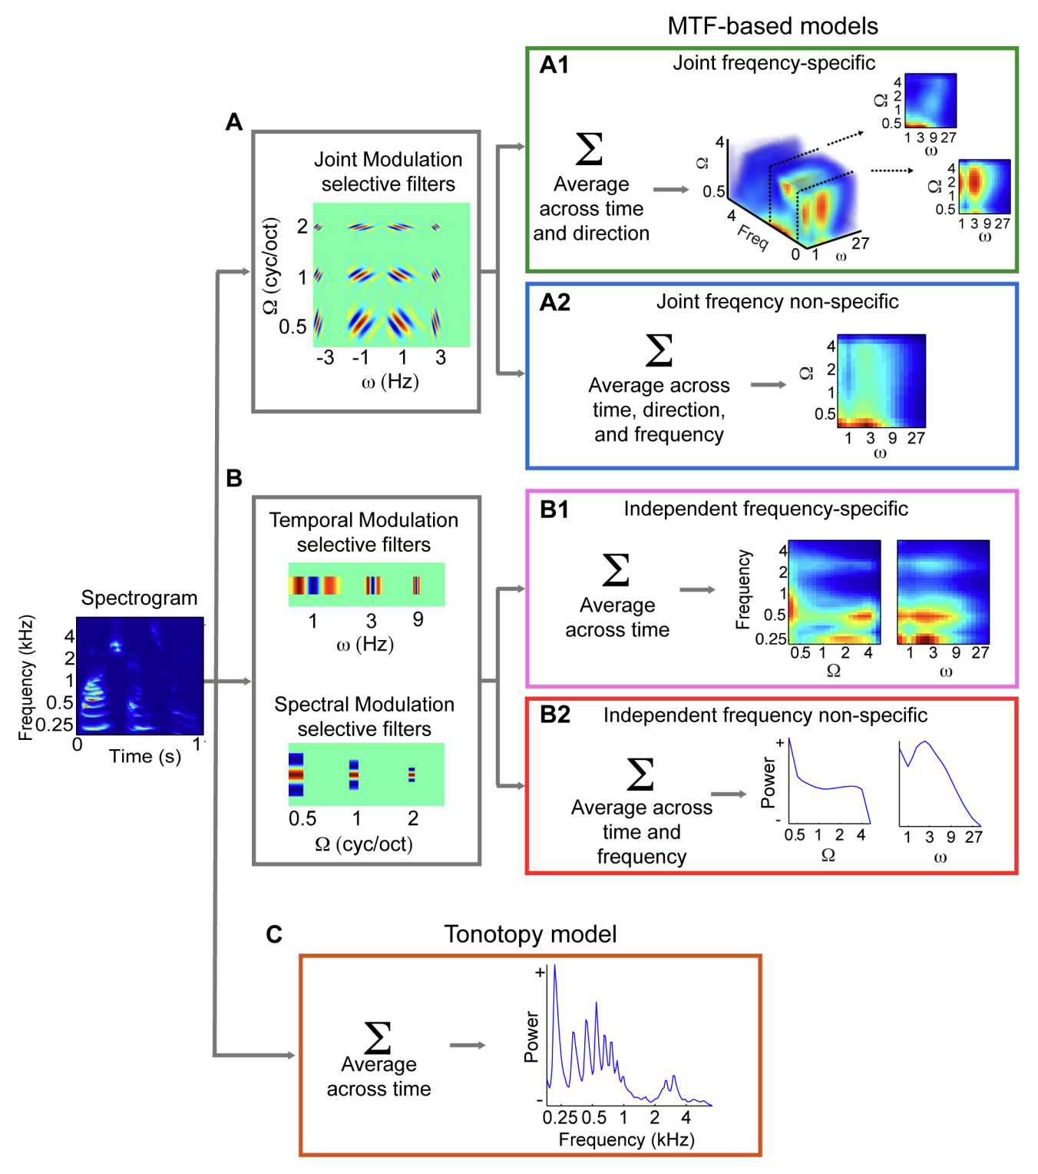
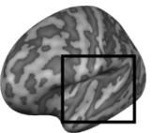
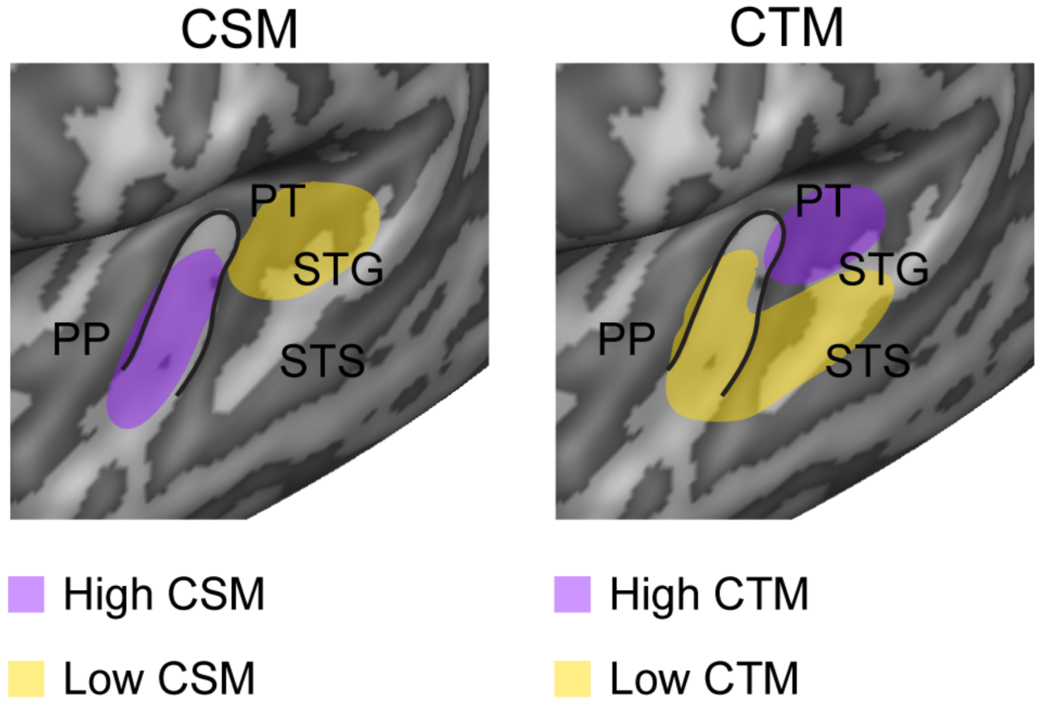
Classic encoding model finding: Audio
Stimuli: natural sounds (speech, music, nature, tools)
Stimulus representation: spectro-temporal filters that are selective for modulations along space and/or time
Brain recording & modality: fMRI, listening
spatial
temporal
posterior/dorsal auditory: coarse spectral info & high temporal precision
anterior/ventral auditory: fine-grained spectral & low temporal precision
Santoro, Roberta, Michelle Moerel, Federico De Martino, Rainer Goebel, Kamil Ugurbil, Essa Yacoub, and Elia Formisano. "Encoding of natural sounds at multiple spectral and temporal resolutions in the human auditory cortex." PLoS computational biology 10, no. 1 (2014): e1003412.

Slide 10
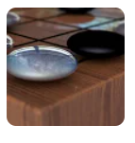

Deep learning models enable data-driven encoding models for naturalistic stimuli
DeepMind’s New AI Taught Itself to Be the World’s Greatest Go Player
Singularity Hub
Meet GPT-3. It Has Learned to Code (and Blog and Argue)
The New York Times

Slide 11
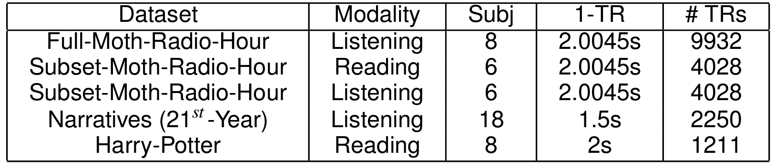
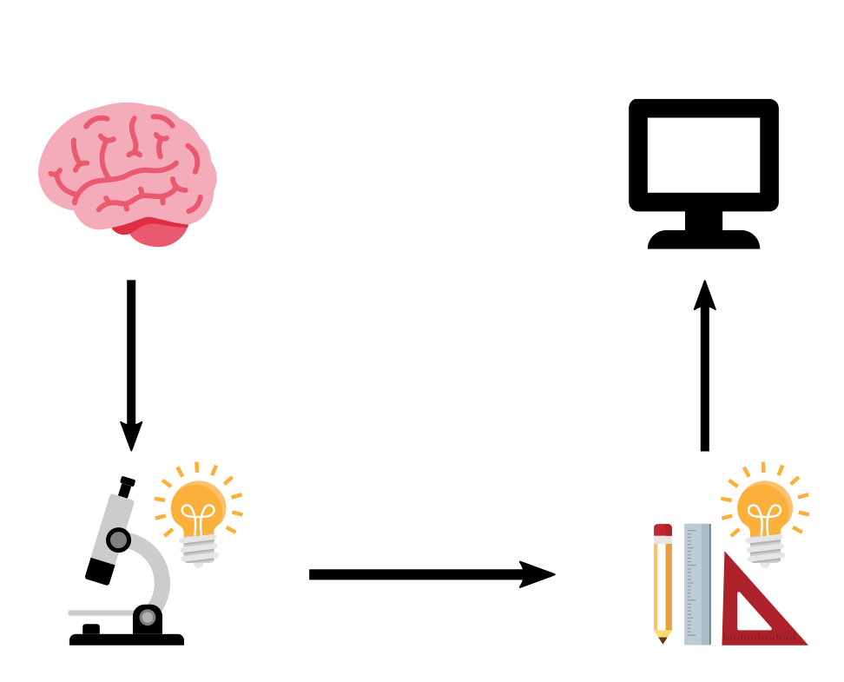

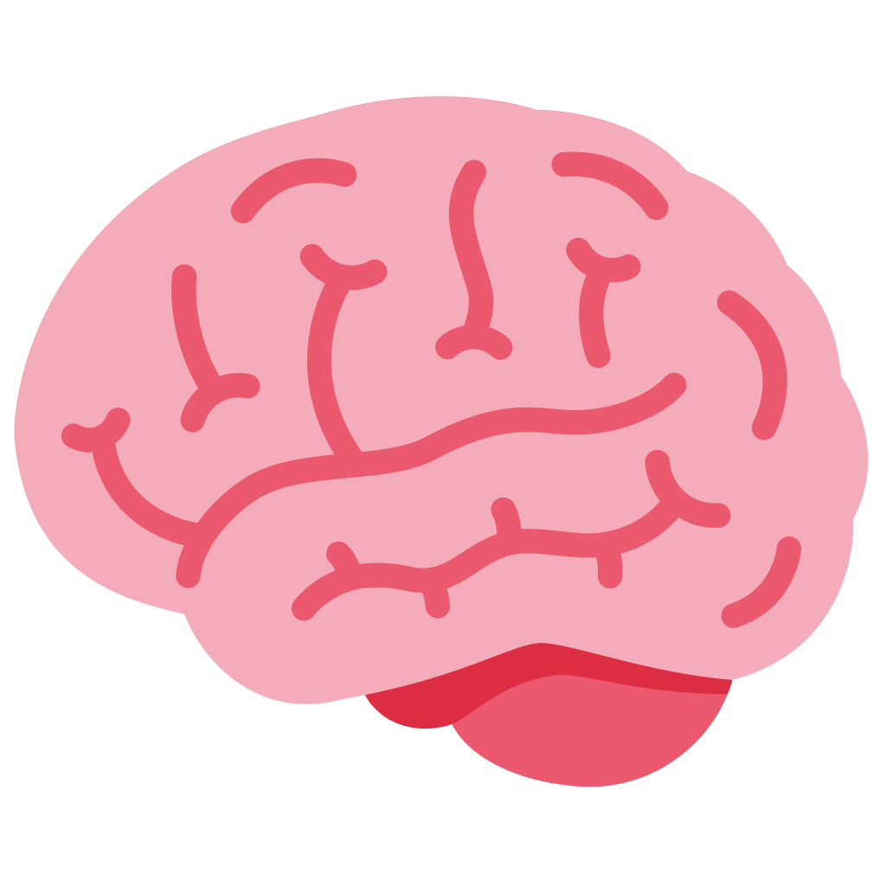
Increasingly available open source ecological stimuli datasets
With advancement of ecological stimuli datasets and open source language models, recent studies looked at interesting open questions?
?
?
Is the “how” of the NLP system process language comprehension the same as “how” of the brain process language comprehension?
How is information aggregated by the brain during language comprehension?
Deniz et al. 2019
Nastase et al. 2021
Li et al. 2022
Lebel et al. 2022
Zhang et al. 2021
Notes:
ecological stimuli -> reading books, listening to stories, watching a movie
The properties of the stimulus that affect brain activity are increasing, so simple representations of the stimuli capture less variance of the brain activity
Meanwhile we have huge progress in deep learning in the last 10 years that gives us AI models that can do many tasks. Of course they are not perfect, and are sometimes flawed, but there is the question of whether we can use their internal representations of the world as rich stimulus representations that perhaps capture some of the properties that are also relevant for the processing in the brain.
Here comes to encoding model

Slide 12
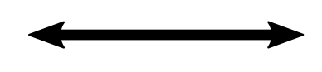
How closely do LLM capabilities relate to those of the human brain?
?
Another language processing system
LLM
?
1: methods to estimate alignment
2: neuroscience background
3: works on alignment between LLMs and brains, and reasons for alignment
4: works on reasons for alignment, and on improving alignment
Questions very much encouraged!!
ICETCI 2024: DL for Brain Encoding and Decoding

Slide 13
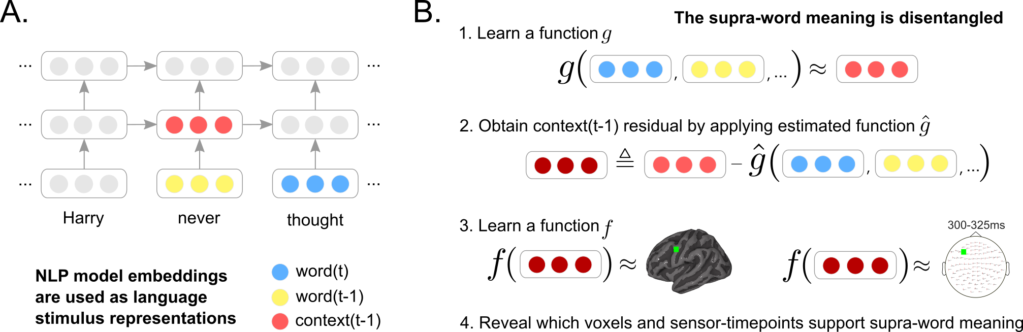

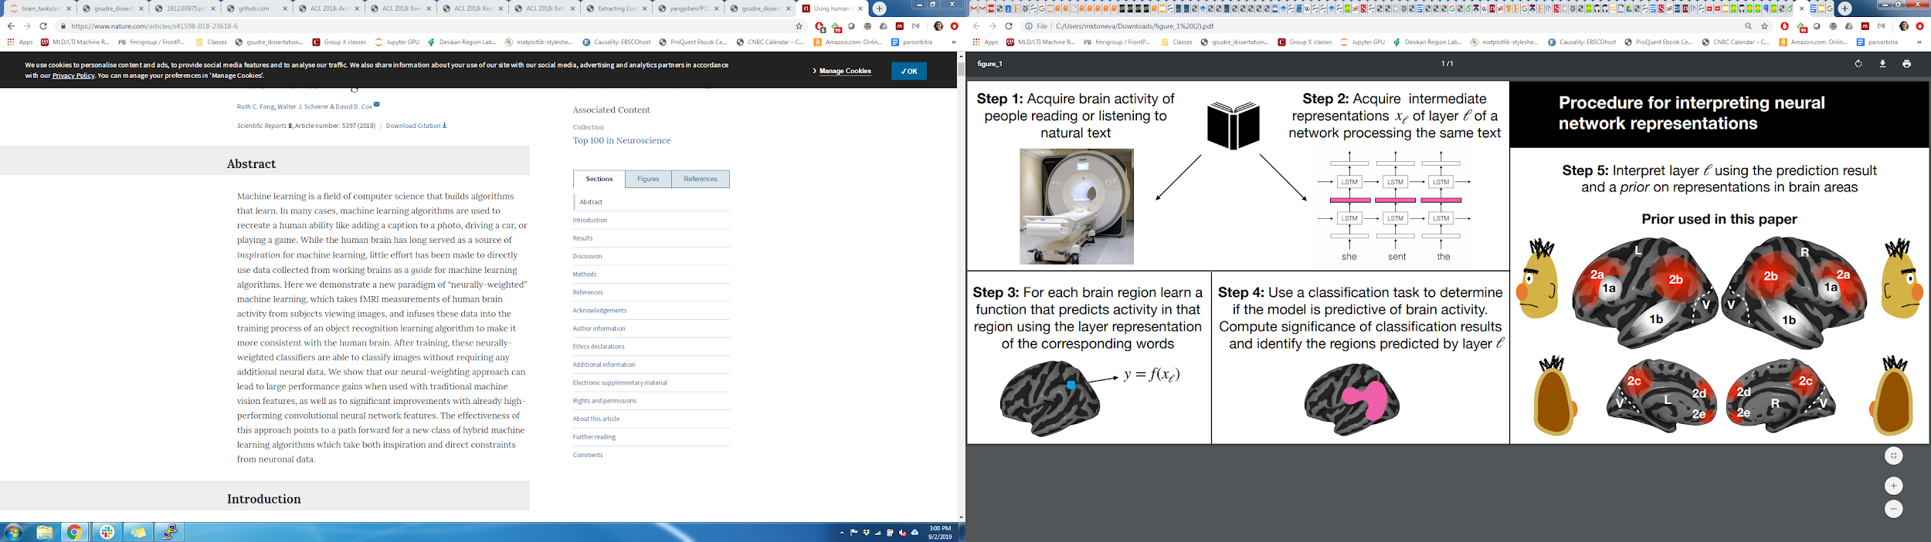
Deep neural networks and brain alignment: brain encoding and decoding
Multimodal ecological stimulus
Deep learning system
A priori locations in DL system and brain
Data-driven encoding model
how are they related?
fMRI
Wehbe et al. 2014,
Jain and Huth 2018,
Gauthier and Levy 2019
Toneva and Wehbe 2019,
Caucheteux et al. 2020,
Toneva et al. 2020
Jain et al. 2020,
Schrimpf et al. 2021,
Goldstein et al. 2022
...
ICETCI 2024: DL for Brain Encoding and Decoding

Slide 14
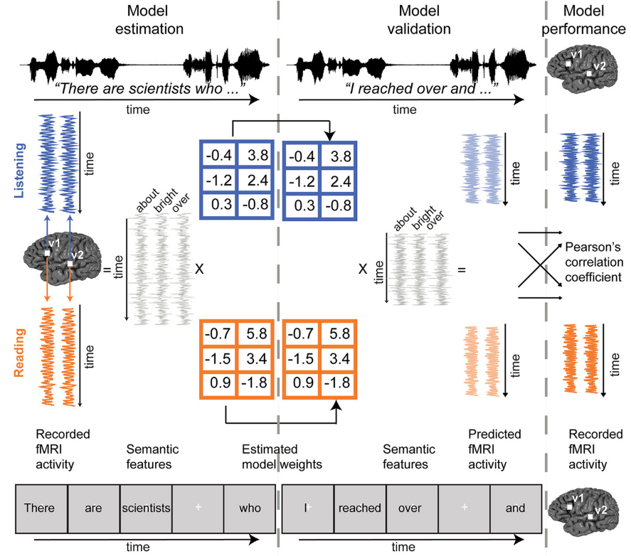

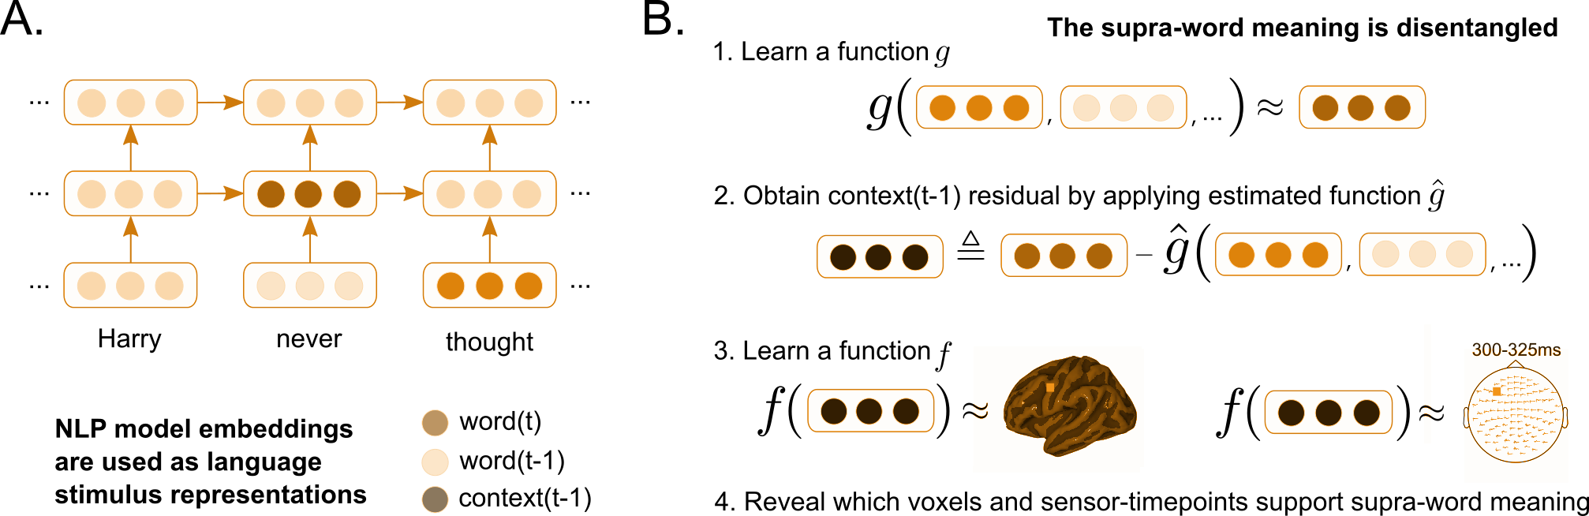
General encoding pipeline to evaluate brain-LM alignment
language model (LM)
a priori locations in NLP system and brain
“Harry never thought
he would ...”
Learn function
𝑥 alignment
~5000 words
fMRI
Test how well predicts unseen brain recordings
Brain alignment of a LM ⇒ how similar its representations are to a human brain’s
Wehbe et al. 2014,
Jain and Huth 2018,
Gauthier and Levy 2019
Toneva and Wehbe 2019,
Caucheteux et al. 2020,
Toneva et al. 2020
Jain et al. 2020,
Schrimpf et al. 2021,
Goldstein et al. 2022
...
ICETCI 2024: DL for Brain Encoding and Decoding

Slide 15
LLMs, estimating alignment, evaluation
language model
a priori locations in NLP system and brain
“Harry never thought
he would ...”
Learn function
𝑥 alignment
~5000 words
fMRI
Test how well predicts unseen brain recordings
ICETCI 2024: DL for Brain Encoding and Decoding

Slide 16
Part 1: LLMs + extracting representations
language model
a priori locations in NLP system and brain
“Harry never thought
he would ...”
Learn function
𝑥 alignment
~5000 words
fMRI
Test how well predicts unseen brain recordings
ICETCI 2024: DL for Brain Encoding and Decoding

Slide 17
LLMs, estimating alignment, evaluation
language model
a priori locations in NLP system and brain
“Harry never thought
he would ...”
Learn function
𝑥 alignment
~5000 words
fMRI
Test how well predicts unseen brain recordings
ICETCI 2024: DL for Brain Encoding and Decoding

Slide 18
Estimating brain-LM alignment + evaluation
language model
a priori locations in NLP system and brain
“Harry never thought
he would ...”
Learn function
𝑥 alignment
~5000 words
fMRI
Test how well predicts unseen brain recordings
ICETCI 2024: DL for Brain Encoding and Decoding

Slide 19
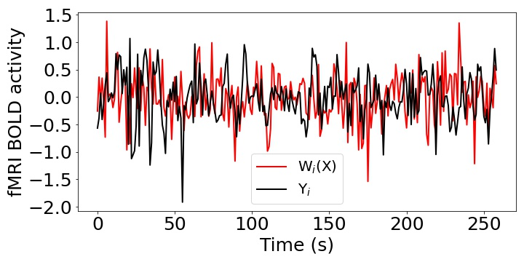
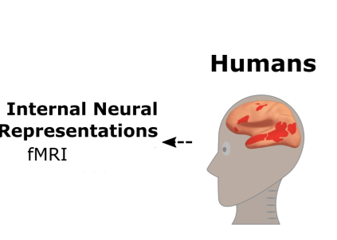
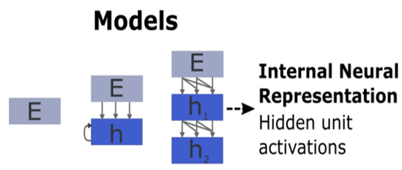
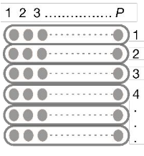
Encoding schema
Pearson Correlation (R) = Corr(Y, W(X))
Stimulus
Stimulus
Input
Present
X
W
Y
Input
Ridge Regression
Output

Slide 20
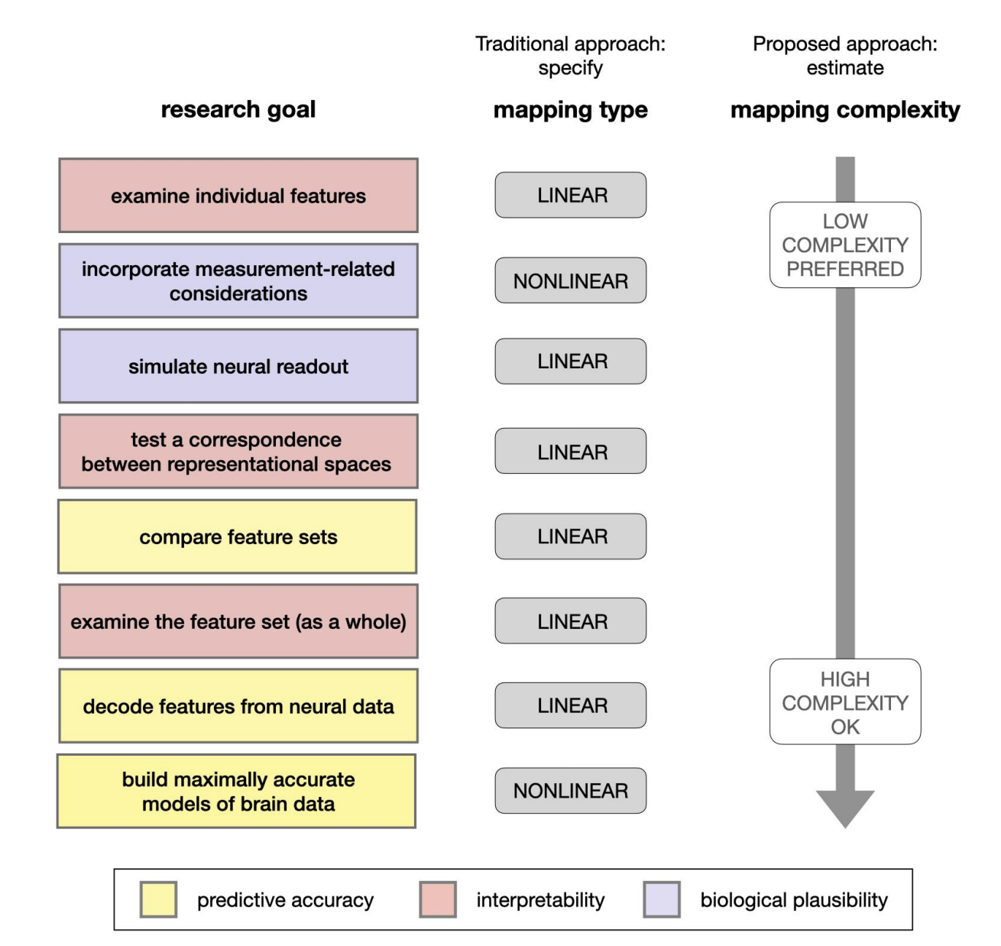
Encoding: training and evaluation
function often modeled as linear
[Mitchell et al. 2008, Nishimoto et al., 2011;
Sudre et al., 2012; Wehbe et al., 2014]
Considerations for
Linear vs non-linear
Ivanova, Anna A., Martin Schrimpf, Stefano Anzellotti, Noga Zaslavsky, Evelina Fedorenko, and Leyla Isik. "Is it that simple? Linear mapping models in cognitive neuroscience." bioRxiv (2021).

Slide 21
Encoding: training and evaluation
function often modeled as linear
[Mitchell et al. 2008, Nishimoto et al., 2011;
Sudre et al., 2012; Wehbe et al., 2014]
Training: cross validation (CV), regularization parameter chosen via nested CV
Evaluation: 1) make predictions for heldout data
2) compare predictions with true brain data
3) stringent statistical testing

Slide 22
Encoding: training setup
Learn function
Goal: find a mapping from stimulus representation to brain data that generalizes to new brain data
Test how well predicts unseen brain recordings
Method:
Split dataset into train, validation, and test
Employ cross-validation to select model parameters based on validation dataset
Reduce overfitting by using regularization
Ridge regularization

Slide 23
Encoding: training independent models
Independent model per participant
P1
P2
PN
…
Independent model per voxel / sensor-timepoint
P1, v1
P1, v2
…
P1, vm

Slide 24
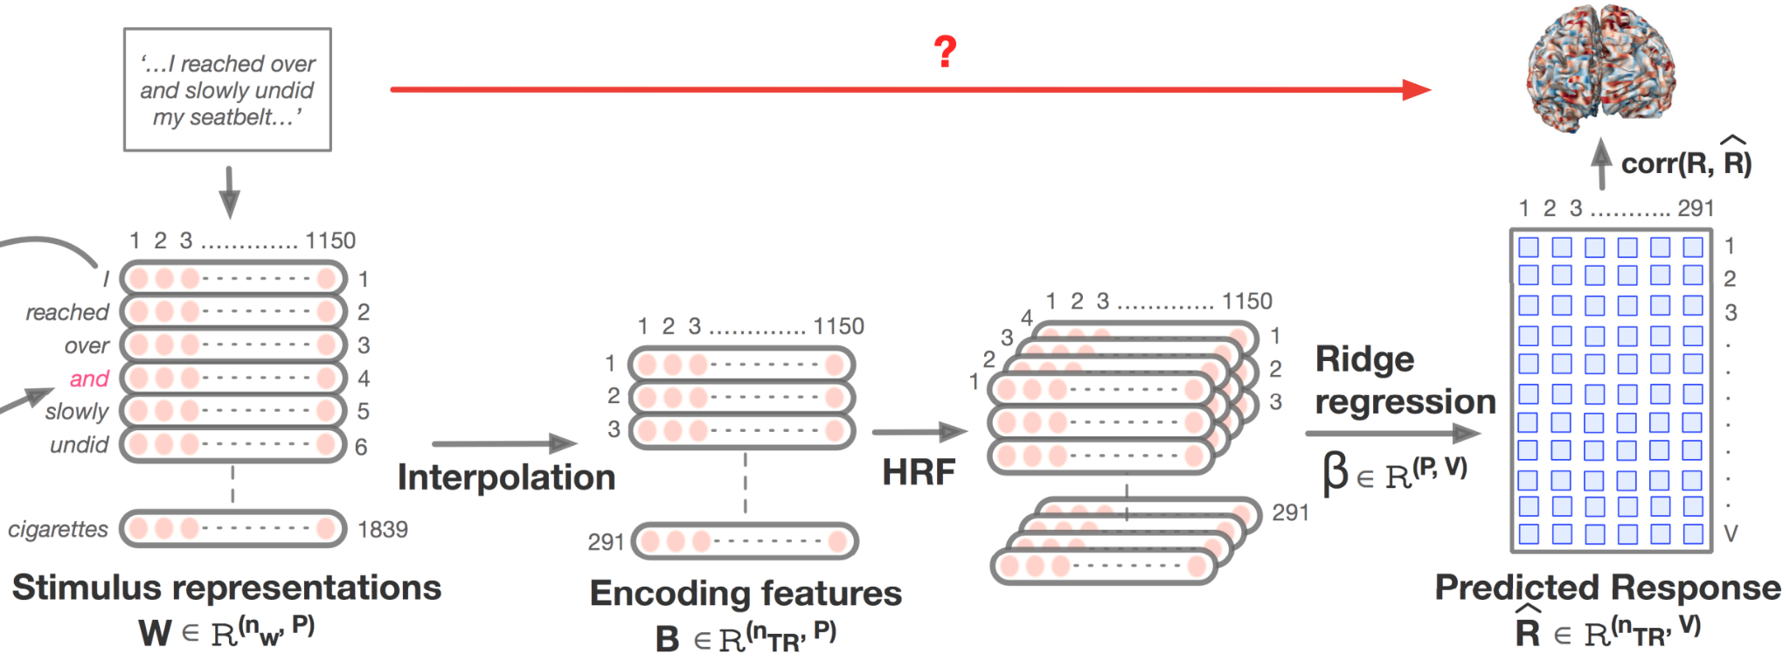
Encoding: fMRI specifics
Jain, Shailee, Vy Vo, Shivangi Mahto, Amanda LeBel, Javier S. Turek, and Alexander Huth. "Interpretable multi-timescale models for predicting fMRI responses to continuous natural speech." Advances in Neural Information Processing Systems 33 (2020): 13738-13749.

Slide 25
Encoding: evaluation setup
Predict data heldout from training by applying learned function to corresponding stimulus representations
Compare predictions of brain data to true brain data:
Evaluation metrics
Learn function
Test how well predicts unseen brain recordings

Slide 26
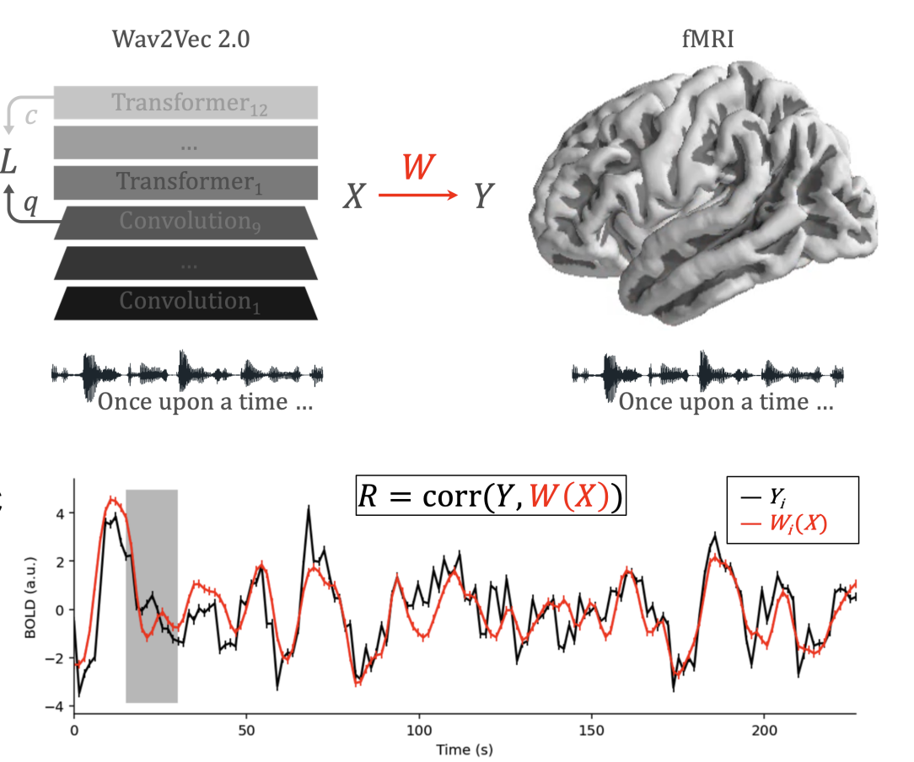
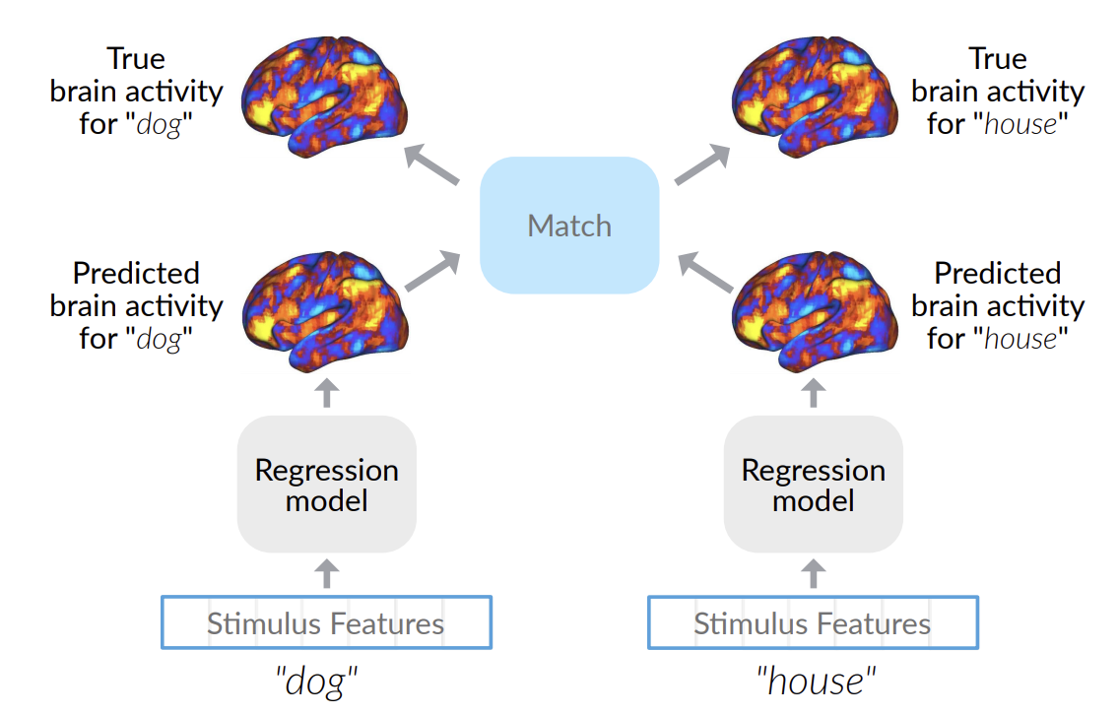
Encoding: evaluation metrics
Pearson correlation
2v2 accuracy
Millet, Juliette, Charlotte Caucheteux, Pierre Orhan, Yves Boubenec, Alexandre Gramfort, Ewan Dunbar, Christophe Pallier, and Jean-Remi King. "Toward a realistic model of speech processing in the brain with self-supervised learning." arXiv preprint arXiv:2206.01685 (2022).
Toneva, Mariya, Otilia Stretcu, Barnabás Póczos, Leila Wehbe, and Tom M. Mitchell. "Modeling task effects on meaning representation in the brain via zero-shot meg prediction." Advances in Neural Information Processing Systems 33 (2020): 5284-5295.

Slide 27
Agenda
Neuro-AI alignment: Introduction [1 hour 15 min]
Introduction to Brain encoding and decoding [30 min]
Types of Brain Recordings [15 min]
Types of Stimulus Representations [30 min]
Coffee break [30 min]
Recent Trends in LLMs [1 hour 15 min]
Small language models [15 min]
Emerging abilities of language models [30 min]
Text-to-Text Transfer Transformer, Prompting, Instruction-tuning [30 min]
Lunch break [1 hour 30 min]
Language and Brain: Deep Learning for Brain Encoding and Decoding [1 hour 15 min]
Linguistic Brain Encoding [60 min]
Encoding pipeline
Pretrained language models and brain alignment
Challenges in using DL for cognitive science
What are the reasons for better brain alignment?
Linguistic Brain Decoding [15 min]
Coffee break [30 min]
Hands-on-session [1 hour 15 min]

Slide 28

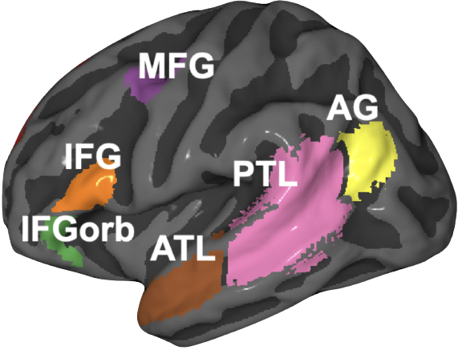
Do pretrained language models align with human brain?
Artificial
Biological
What are the reasons behind better similarity between language models and brains?

Slide 29
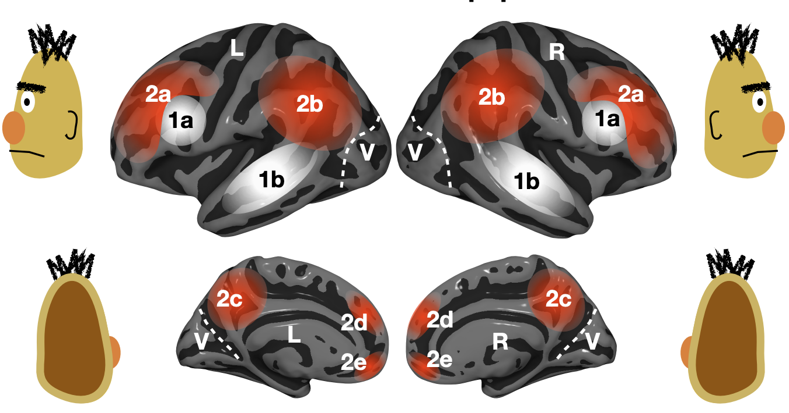
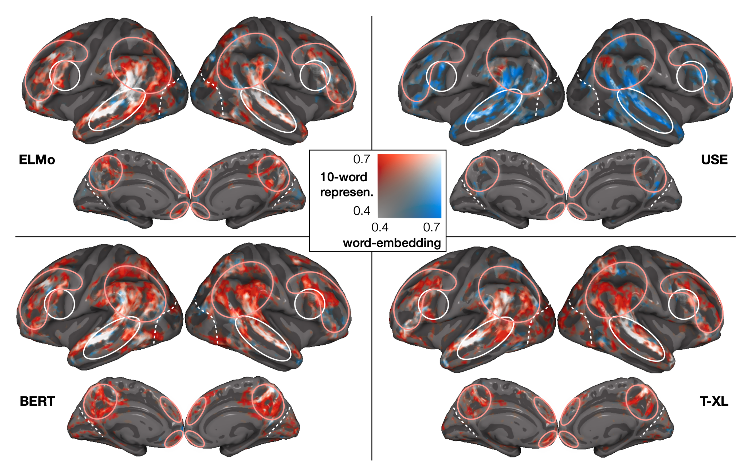
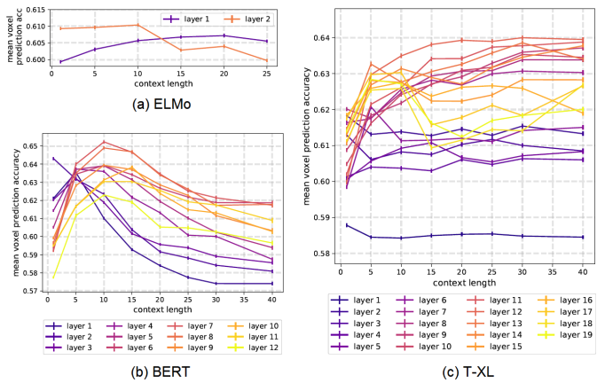
Language: work utilizing DL progress
Stimuli: one chapter of Harry Potter
Stimulus representation: derived from pretrained NLP systems
Brain recording & modality: fMRI, reading
across several types of large NLP systems, best alignment with fMRI in middle layers
Toneva, M., & Wehbe, L. (2019). Interpreting and improving natural-language processing (in machines) with natural language-processing (in the brain). Advances in Neural Information Processing Systems, 32.

Slide 30
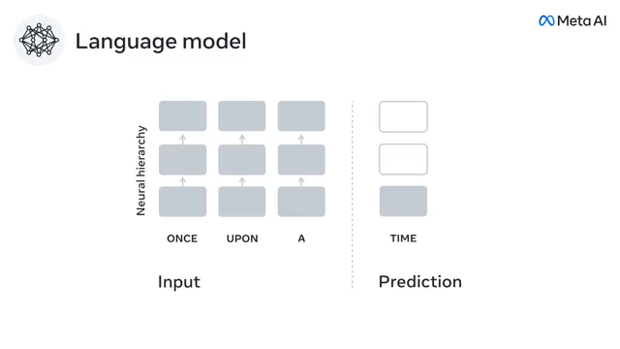
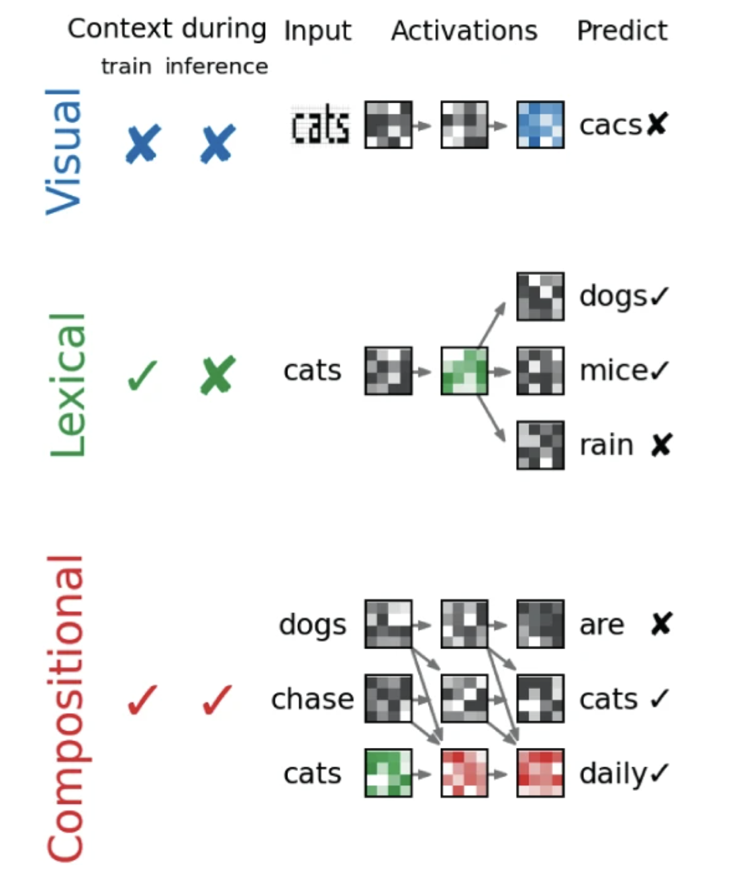
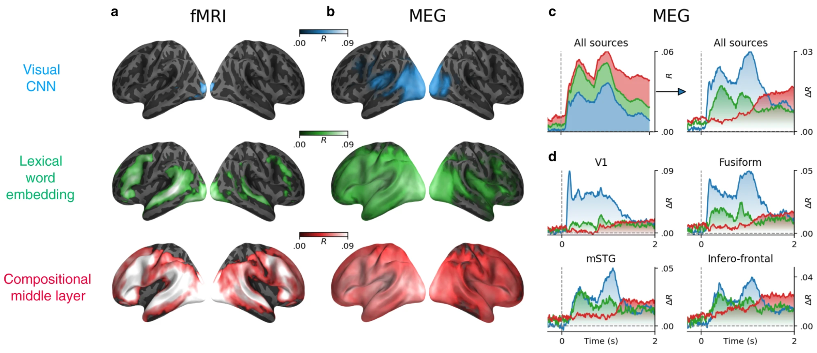
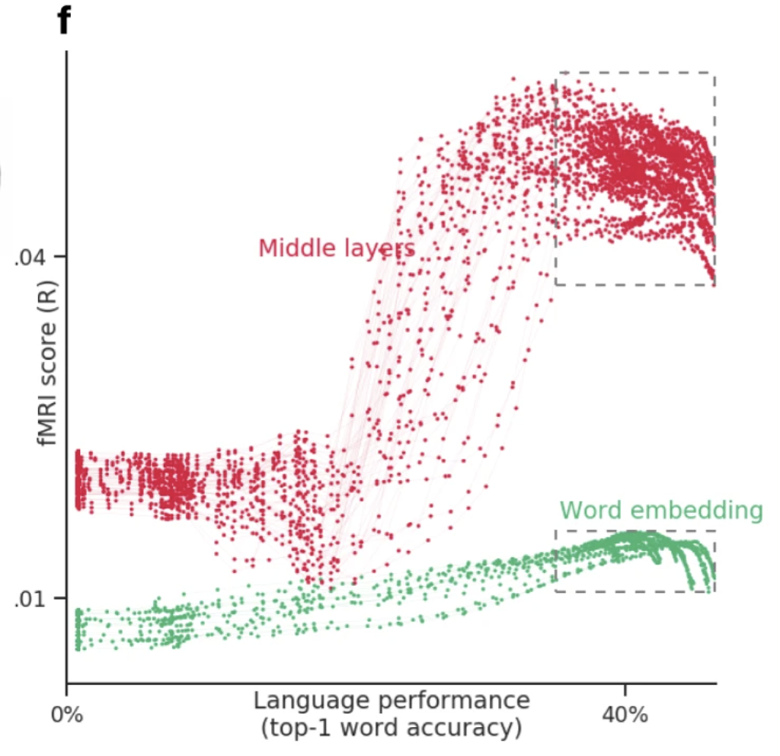
Language: work utilizing DL progress
best alignment with fMRI & MEG in middle layers
better performance at predicting next word -> better prediction of fMRI & MEg
Stimuli: sentences
Stimulus representation: derived from pretrained NLP systems
Brain recording & modality: MEG & fMRI, reading
Caucheteux, Charlotte, and Jean-Rémi King. "Brains and algorithms partially converge in natural language processing." Communications biology 5, no. 1 (2022): 1-10.

Slide 31
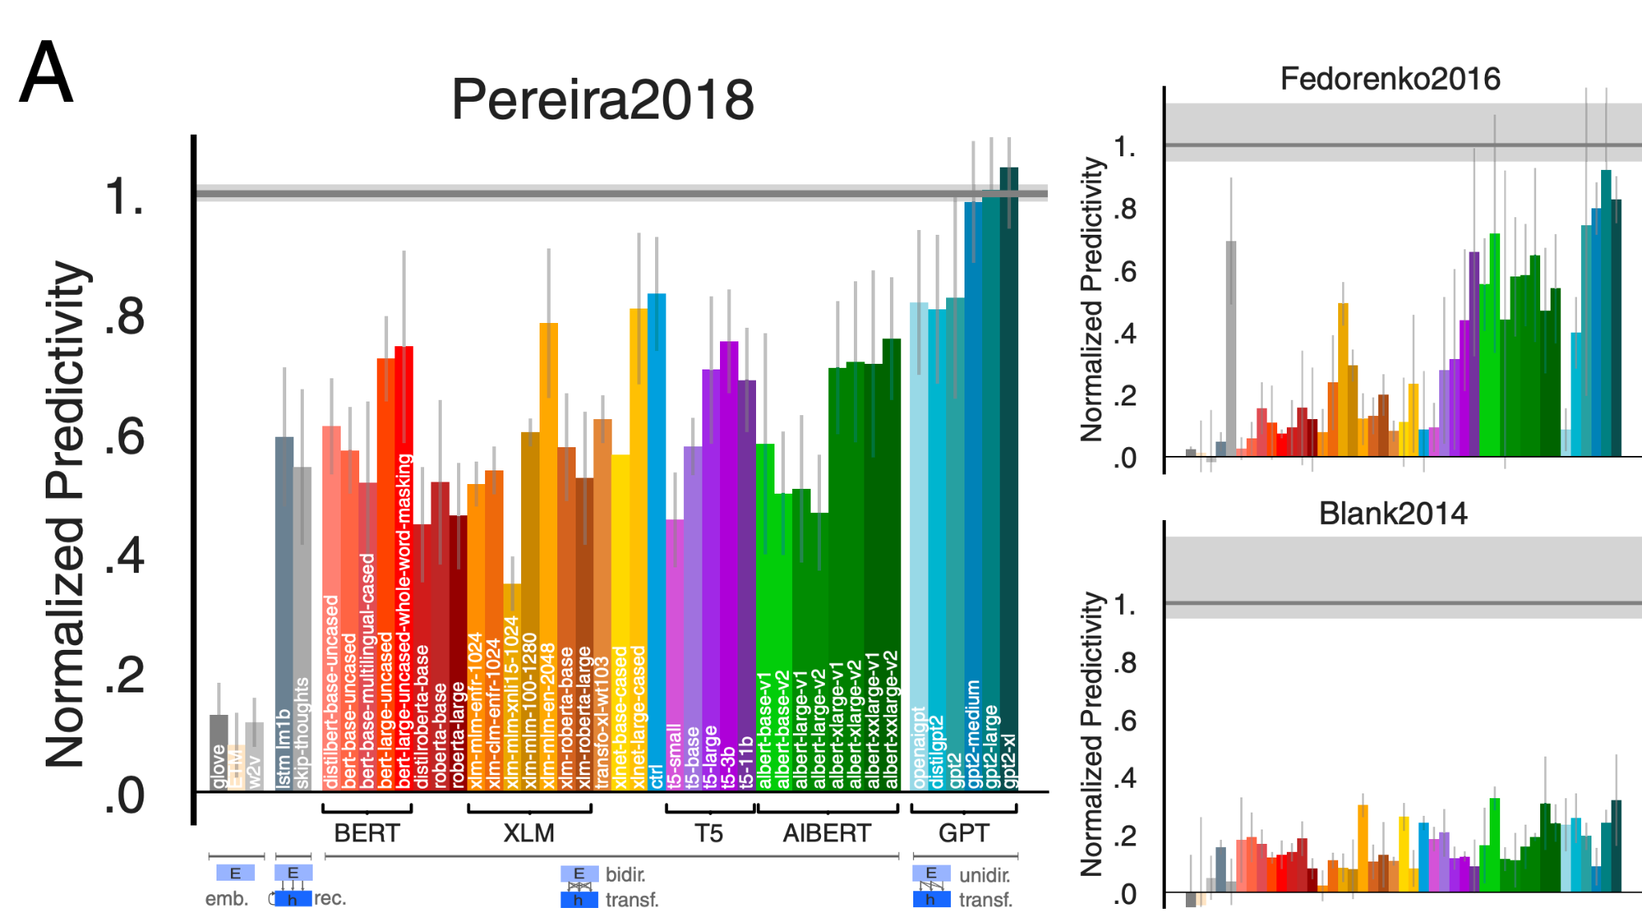
Language: work utilizing DL progress
Stimuli: sentences, passages, short story
Stimulus representation: derived from pretrained NLP systems (BERT, GPT-2, T5 , and XLM)
Brain recording & modality: fMRI & ECoG, reading & listening
some NLP systems can predict fMRI and ECoG up to 100% of estimated noise ceiling
Schrimpf, Martin, Idan Asher Blank, Greta Tuckute, Carina Kauf, Eghbal A. Hosseini, Nancy Kanwisher, Joshua B. Tenenbaum, and Evelina Fedorenko. "The neural architecture of language: Integrative modeling converges on predictive processing." Proceedings of the National Academy of Sciences 118, no. 45 (2021): e2105646118.
Notes:
The datasets varied in the imagingmodality (fMRI/ECoG), the nature of the materials (uncon-nected sentences/passages/stories), the grain of linguistic unitsto which responses were recorded (sentences/words/2-s-longstory fragments), and presentation modality (reading/listening).
We find that the most powerful models predict neural and behavioral responses across different datasets up to noise levels. Models that perform better at predicting the next word in a sequence also better predict brain measurements
Next-word-prediction task performance is predictive of reading times
Brain scores correlate with behavioral scores

Slide 32
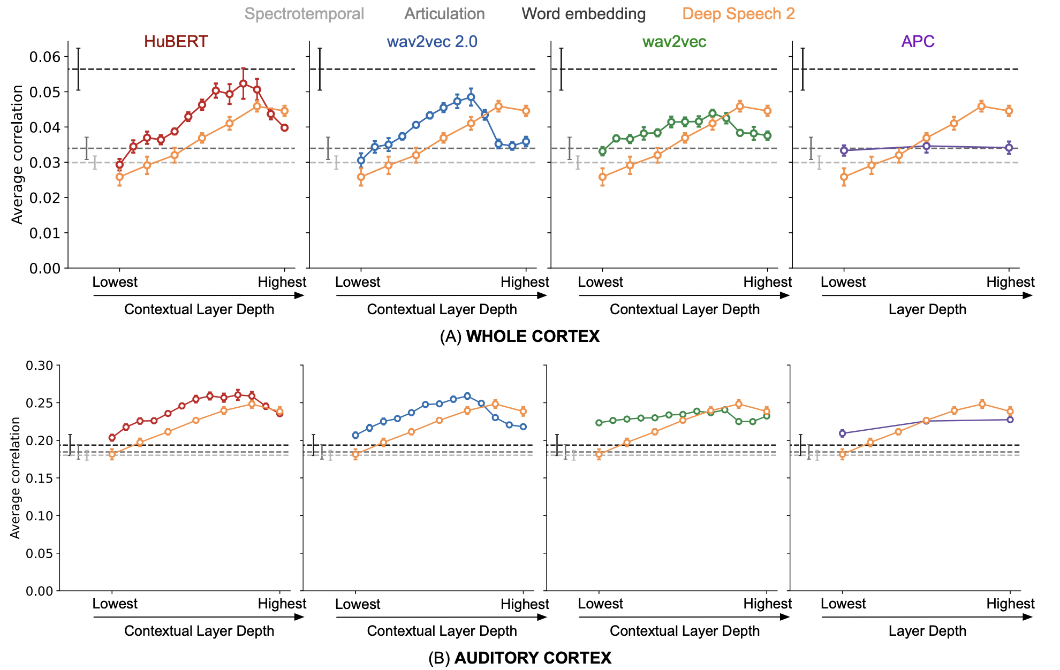
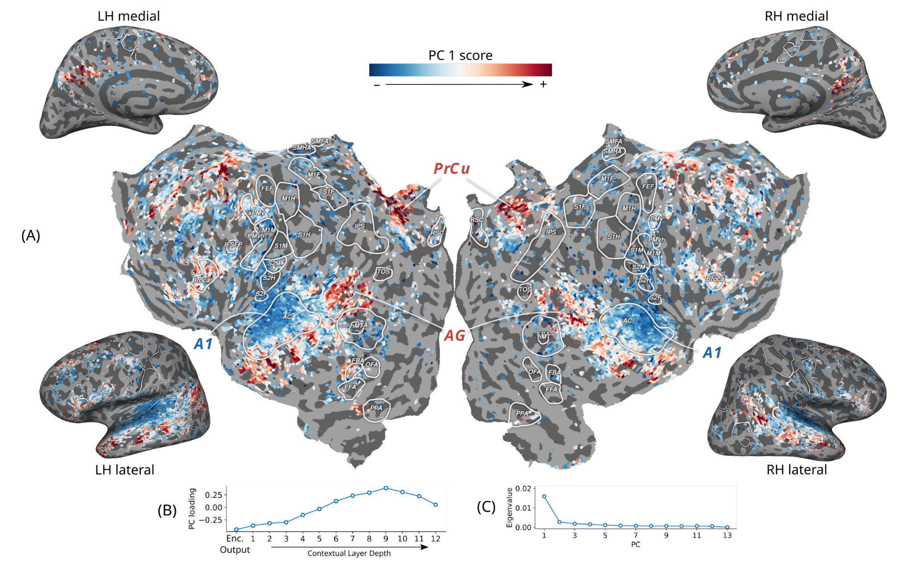
Audio: work utilizing DL progress
Stimuli: Moth Radio Hour
Stimulus representation: derived from pretrained self-supervised speech models
Brain recording & modality: fMRI, listening
Middle layers of self-supervised speech models predict auditory cortex the best
Vaidya, Aditya R., Shailee Jain, and Alexander G. Huth. "Self-supervised models of audio effectively explain human cortical responses to speech." ICML (2022).

Slide 33
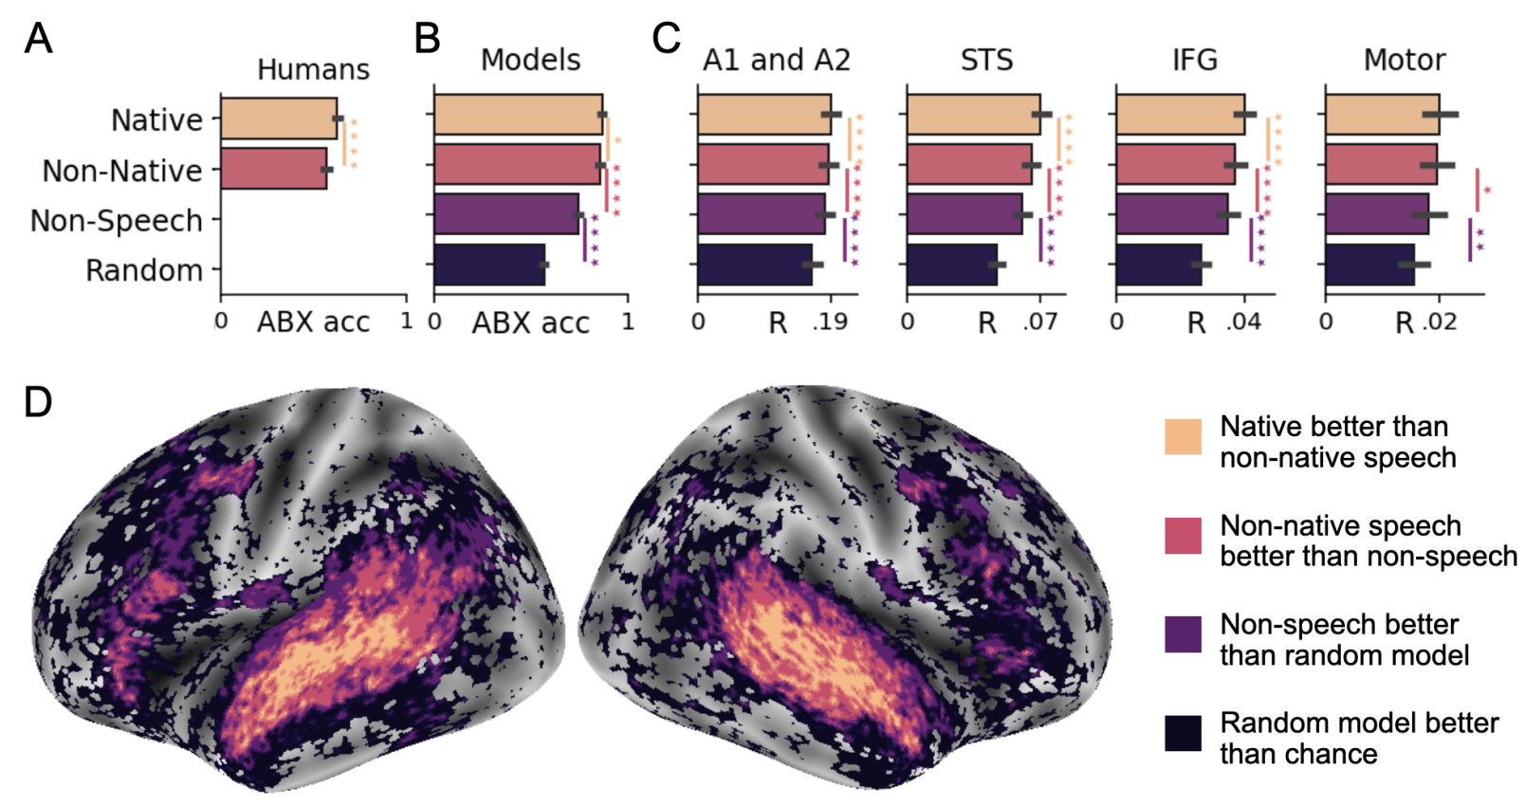
Audio: work utilizing DL progress
Stimuli: audio books
Stimulus representation: derived from pretrained self-supervised speech model
Brain recording & modality: fMRI, listening in 3 languages (Eng, Fr, Mandarin)
Self-supervised speech models reveal specialization for native sounds in the STS and MTG;
IFG and AG show more general specialization for speech rather than native-language
Millet, Juliette, Charlotte Caucheteux, Pierre Orhan, Yves Boubenec, Alexandre Gramfort, Ewan Dunbar, Christophe Pallier, and Jean-Remi King. "Toward a realistic model of speech processing in the brain with self-supervised learning." arXiv preprint arXiv:2206.01685 (2022).

Slide 34
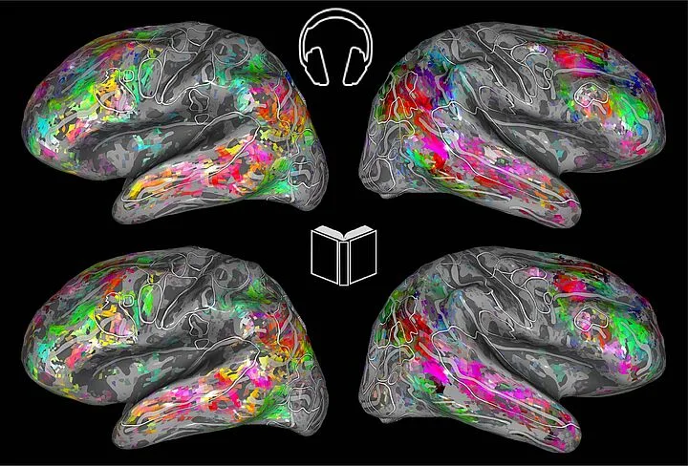
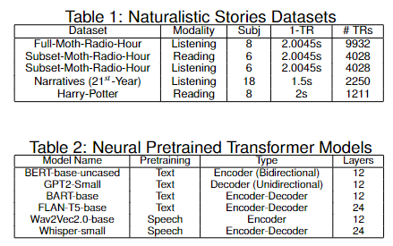
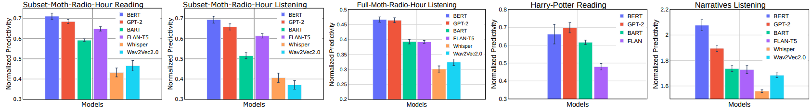
Aspects of NLP models and Brain datasets
Stimuli: Narrative Stories
Stimulus representation: pretrained NLP model and speech models
Brain recording & modality: fMRI, Reading, Listening
Questions: Is the choice of stimulus modality (reading vs. listening) important for the study of brain alignment?
Are all naturalistic fMRI datasets equally good for brain encoding?
How does the type of model (text vs. speech and encoder vs. decoder) affect the resulting alignment?
Text models predict fMRI recordings significantly better than speech models
Oota, Subba Reddy, Gupta, Manish and Toneva, Mariya. "Joint processing of linguistic properties in brains and language models." 2022 arXiv.
Notes:
In this study, we propose novel multi-dimensional features that encode information about the syntactic structure of sentences.
First, we find that our syntactic structure-based features explain additional variance in the brain activity of various parts of the language system, even after controlling for complexity metrics that capture processing load.
At the same time, we see that regions well-predicted by syntactic features are distributed in the language system and are not distinguishable from those processing semantics.

Slide 35
Agenda
Neuro-AI alignment: Introduction [1 hour 15 min]
Introduction to Brain encoding and decoding [30 min]
Types of Brain Recordings [15 min]
Types of Stimulus Representations [30 min]
Coffee break [30 min]
Recent Trends in LLMs [1 hour 15 min]
Small language models [15 min]
Emerging abilities of language models [30 min]
Text-to-Text Transfer Transformer, Prompting, Instruction-tuning [30 min]
Lunch break [1 hour 30 min]
Language and Brain: Deep Learning for Brain Encoding and Decoding [1 hour 15 min]
Linguistic Brain Encoding [60 min]
Encoding pipeline
Pretrained language models and brain alignment.
Challenges in using DL for cognitive science
What are the reasons for better brain alignment?
Linguistic Brain Decoding [15 min]
Coffee break [30 min]
Hands-on-session [1 hour 15 min]

Slide 36
Challenges in using DL for cognitive science
Not designed to specifically model brain processing
NLP systems: Designed to predict upcoming words
Harry never thought ???
Harry never thought he ???
Harry never thought he would ???
...

Slide 37
Challenges in using DL for cognitive science
Not designed to specifically model brain processing
Training DL models using brain recordings
Task-based modeling

Slide 38
Challenges in using DL for cognitive science
Not designed to specifically model brain processing
Training DL models using brain recordings
Task-based modeling
Can be difficult to interpret due to multiple sources of information
part-of-speech
+
semantic role
?
+
dependence on other words
+
...

Slide 39
Challenges in using DL for cognitive science
Not designed to specifically model brain processing
Training DL models using brain recordings
Task-based modeling
Can be difficult to interpret due to multiple sources of information
Disentangling contributions of different info sources to brain predictions

Slide 40
Challenges in using DL for cognitive science
Not designed to specifically model brain processing
Training DL models using brain recordings
Task-based modeling
Can be difficult to interpret due to multiple sources of information
Disentangling contributions of different info sources to brain predictions

Slide 41
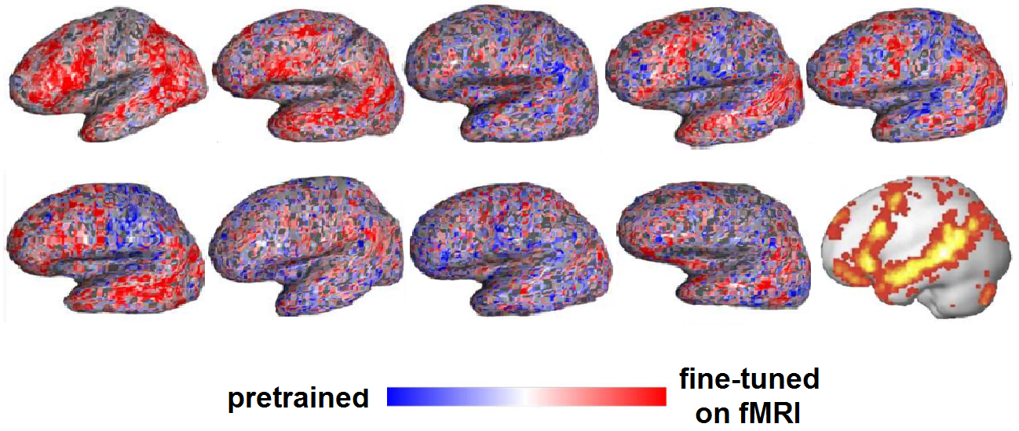
Training DL models using brain recordings
Stimuli: one chapter of Harry Potter
Stimulus representation: brain-optimized NLP model
Brain recording & modality: fMRI & MEG, reading
Chapter of a book
NLP system
A priori locations in NLP system and brain
error propagation
Brain-optimized NLP model predicts unseen fMRI recordings better, especially in canonical language regions
𝑥 alignment
fMRI
Schwartz, Dan, Mariya Toneva, and Leila Wehbe. "Inducing brain-relevant bias in natural language processing models." Advances in neural information processing systems 32 (2019).
Notes:
we presented an approach that directly introduced brain-relevant language bias in an NLP model by explicitly training an NLP model to predict language-induced brain recordings. To achieve this, we fine-tuned all parameters of a state-of-the-art NLP model, which was already pre-trained in a self-supervised fashion on a large amount of text, to predict two different types of brain imaging measurements---fMRI and Magnetoencephalography (MEG)---of people reading the same chapter of a popular book. We included two different imaging modalities to discourage the encoded bias' dependence on a specific imaging modality. In fact, we showed that for some participants, when a model is trained to predict MEG data, the resulting changes to the language-encoding that the model uses benefit subsequent training on fMRI data compared to starting with a language model trained only on text. This suggests that the changes to the language representations induced by the MEG data are not entirely imaging modality-specific, and that indeed the model is learning the relationship between language and brain activity as opposed to the relationship between language and a brain activity recording modality. We showed that the resulting model leads to improved prediction of previously unseen brain recordings, specifically in regions that are known to support language processing. This study demonstrates the feasibility of directly biasing language models to learn relationships between text and brain activity.

Slide 42
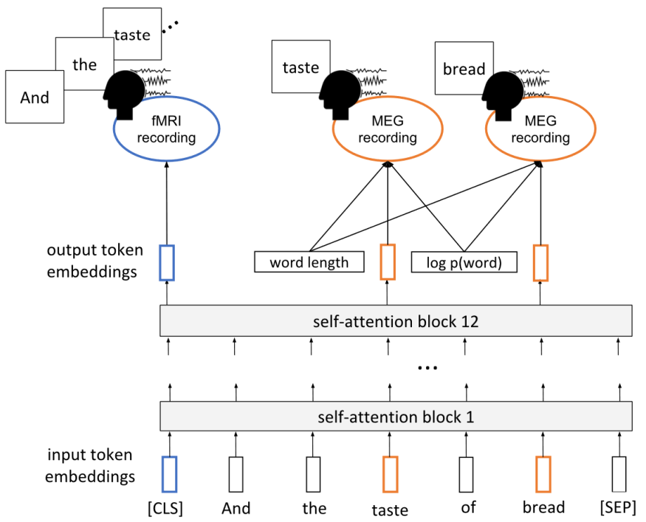

Inducing Brain Relevant Bias
Schwartz, Dan, Mariya Toneva, and Leila Wehbe. "Inducing brain-relevant bias in natural language processing models." Advances in neural information processing systems 32 (2019).

Slide 43
Challenges in using DL for cognitive science
Not designed to specifically model brain processing
Training DL models using brain recordings
Task-based modeling
Can be difficult to interpret due to multiple sources of information
Disentangling contributions of different info sources to brain predictions

Slide 44


Tasks affect processing
Stimuli: passages and narratives
Stimulus representation: task-optimized NLP models for a range of tasks
Brain recording & modality: fMRI, reading & listening of different stimuli
Reading fMRI best explained by coref. resolution, NER, shallow syntax parsing
Listening fMRI best explained by paraphrasing, summarization, NLI
Oota, Subba Reddy, Jashn Arora, Veeral Agarwal, Mounika Marreddy, Manish Gupta, and Bapi Raju Surampudi. "Neural Language Taskonomy: Which NLP Tasks are the most Predictive of fMRI Brain Activity?." arXiv preprint arXiv:2205.01404 (2022).
Notes:
Features from coreference resolution, NER, and shallow syntax parsing explain greater variance for the reading activity. On the other hand, for the listening activity, tasks such as paraphrase generation, summarization, and natural language inference show better encoding performance
And obv different experiments with different stimuli
Need better all tasks annotated on the same initial dataset

Slide 45






How to build better Language models?
Model trained with language modeling
input
input
Model trained to summarize narratives
book chapter
activations
activations
Use model’s internal layer activations to predict brain activity on held-out data
Compare against actual brain recordings
(brain alignment)
Notes:
We use the models’ internal layer activations to predict brain activity on unseen data.
[CLICK] Finally, we compare the brain activity predictions against the actual brain recordings. This comparison serves as the amount of brain alignment.

Slide 46


Result: Summarize narratives → Greater brain alignment 🧠
brain alignment (Pearson correlation)
Training language models to summarize narratives improves brain alignment
this is the title of our paper!
Notes:
In our first result figure, we will show that models trained to summarize narratives indeed have greater brain alignment.
the x-axis represents the amount of brain alignment.
The y-axis compares the 4 pairs of Language models.
Blue bars represent the base models, and orange bars represent the booksum models.
Note that the Pearson correlation values on the x-axis are relatively low in magnitude because they include a large number of brain areas that may not be significantly involved in brain alignment or language processing. Also, these results are an average of many different layers and input sequence lengths that we tested for each language model.
From our results, we see that booksum LMs have greater brain alignment than base LMs.
[CLICK]
Therefore, training language models to summarize narratives improves brain alignment.

Slide 47
Agenda
Neuro-AI alignment: Introduction [1 hour 15 min]
Introduction to Brain encoding and decoding [30 min]
Types of Brain Recordings [15 min]
Types of Stimulus Representations [30 min]
Coffee break [30 min]
Recent Trends in LLMs [1 hour 15 min]
Small language models [15 min]
Emerging abilities of language models [30 min]
Text-to-Text Transfer Transformer, Prompting, Instruction-tuning [30 min]
Lunch break [1 hour 30 min]
Language and Brain: Deep Learning for Brain Encoding and Decoding [1 hour 15 min]
Linguistic Brain Encoding [60 min]
Encoding pipeline
Pretrained language models and brain alignment
Challenges in using DL for cognitive science
What are the reasons for better brain alignment?
Linguistic Brain Decoding [15 min]
Coffee break [30 min]
Hands-on-session [1 hour 15 min]

Slide 48


Joint processing of linguistic properties in brains and language models
Stimuli: Narrative Stories
Stimulus representation: pretrained NLP model and removal of linguistic properties
Brain recording & modality: fMRI, Listening
Questions: What linguistic properties underlie brain alignment, across all layers but also specifically in middle layers?
Top constituents and Tree Depth contribute the most to the alignment trend across layers
Oota, Subba Reddy, Gupta, Manish and Toneva, Mariya. "Joint processing of linguistic properties in brains and language models." NeurIPS 2023.
Notes:
In this study, we propose novel multi-dimensional features that encode information about the syntactic structure of sentences.
First, we find that our syntactic structure-based features explain additional variance in the brain activity of various parts of the language system, even after controlling for complexity metrics that capture processing load.
At the same time, we see that regions well-predicted by syntactic features are distributed in the language system and are not distinguishable from those processing semantics.

Slide 49






What are the reasons for this observed brain alignment?
Investigate via a perturbation approach
Linguistic property
Residual =
Residual encoding performance
Significant difference ⇒ Ling. prop. affects alignment
This is Los Angeles. And it's the …
Original encoding performance
Language model
Naturalistic stimulus
fMRI

Slide 50


Speech language models lack important brain relevant semantics
Stimuli: Narrative Stories
Stimulus representation: pretrained NLP model and speech models
Brain recording & modality: fMRI, Reading, Listening
Questions: Why do text-based language models predict early auditory cortices to an impressive degree?
What types of information do language models truly predict in the Brain?
How does the type of model (text vs. speech) affect the resulting alignment?
Speech models (🔊) useful for modeling early listening: investigate speech models to learn more about AC
Text models (📖) useful for modeling late language in both listening and reading
But, more work to do for a complete end-to-end model of reading and listening in 🧠
Subba Reddy Oota, Emin Çelik, Fatma Deniz, Mariya Toneva. "Speech language models lack important brain-relevant semantics." ACL 2024.
Notes:
In this study, we propose novel multi-dimensional features that encode information about the syntactic structure of sentences.
First, we find that our syntactic structure-based features explain additional variance in the brain activity of various parts of the language system, even after controlling for complexity metrics that capture processing load.
At the same time, we see that regions well-predicted by syntactic features are distributed in the language system and are not distinguishable from those processing semantics.

Slide 51

What types of information lead to high brain alignment?
Investigate via a perturbation approach
Notes:
We investigated this question via a perturbation approach

Slide 52
Agenda
Neuro-AI alignment: Introduction [1 hour 15 min]
Introduction to Brain encoding and decoding [30 min]
Types of Brain Recordings [15 min]
Types of Stimulus Representations [30 min]
Coffee break [30 min]
Recent Trends in LLMs [1 hour 15 min]
Small language models [15 min]
Emerging abilities of language models [30 min]
Text-to-Text Transfer Transformer, Prompting, Instruction-tuning [30 min]
Lunch break [1 hour 30 min]
Language and Brain: Deep Learning for Brain Encoding and Decoding [1 hour 15 min]
Linguistic Brain Encoding [60 min]
Encoding pipeline
Pretrained language models and brain alignment
Challenges in using DL for cognitive science
What are the reasons for better brain alignment?
Linguistic Brain Decoding [15 min]
Coffee break [30 min]
Hands-on-session [1 hour 15 min]

Slide 53

Linguistic Decoding
Defossez et al, 2023

Slide 54










Collaborators
Subba Reddy Oota
Jashn Arora
Veeral Agarwal
Mounika Marreddy
Khushbu Pahwa
Nathan Trouvain
Manish Gupta
Mariya Toneva
Bapi Raju Surampudi
Fatma Deniz
Xavier Hinaut
Frederic Alexandre

